Slide 1
Story Telling with Data
Sprint 5 Project

Slide 2
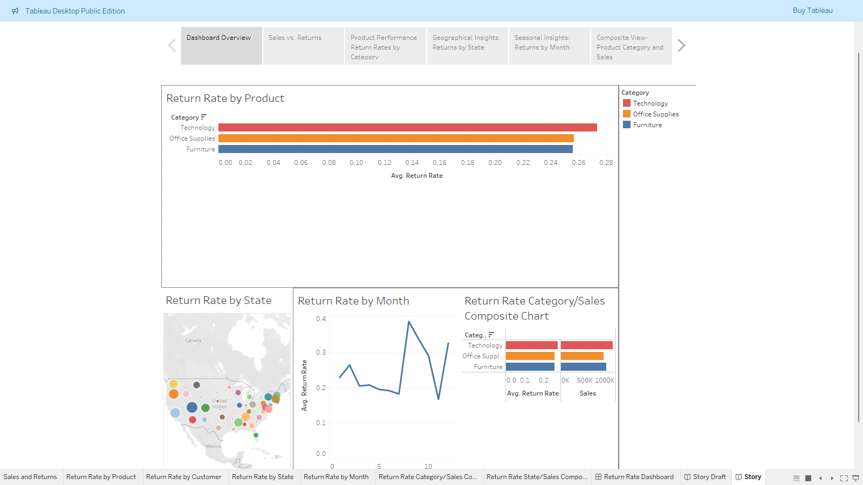
Dashboard Overview

Slide 3
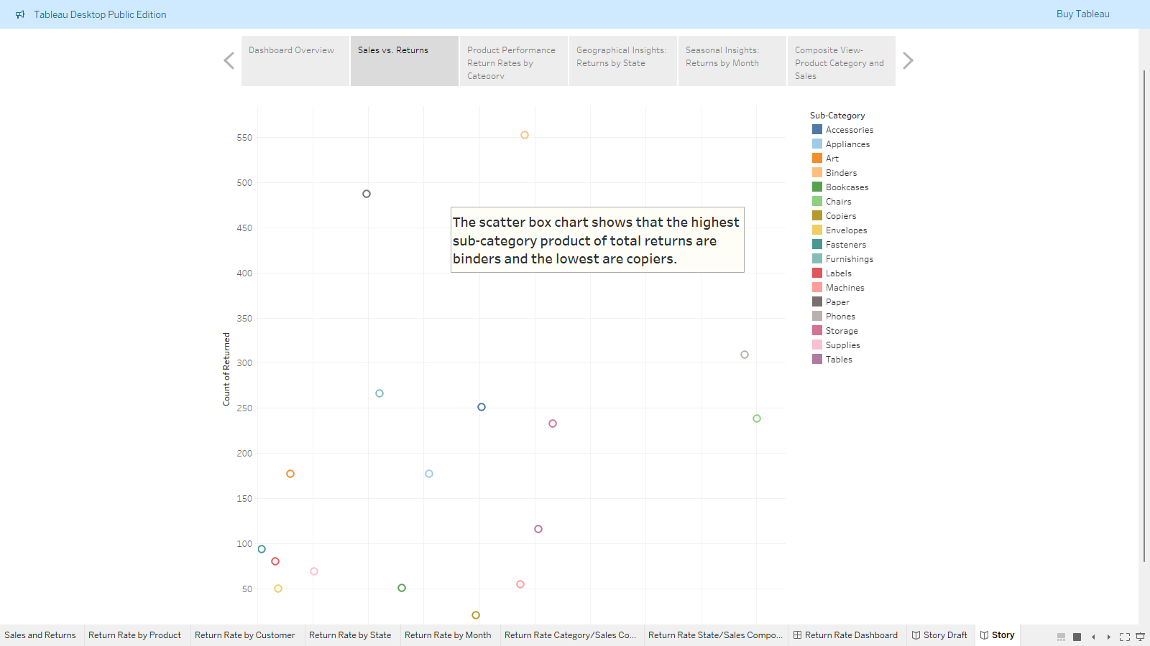
Sales vs. Returns

Slide 4
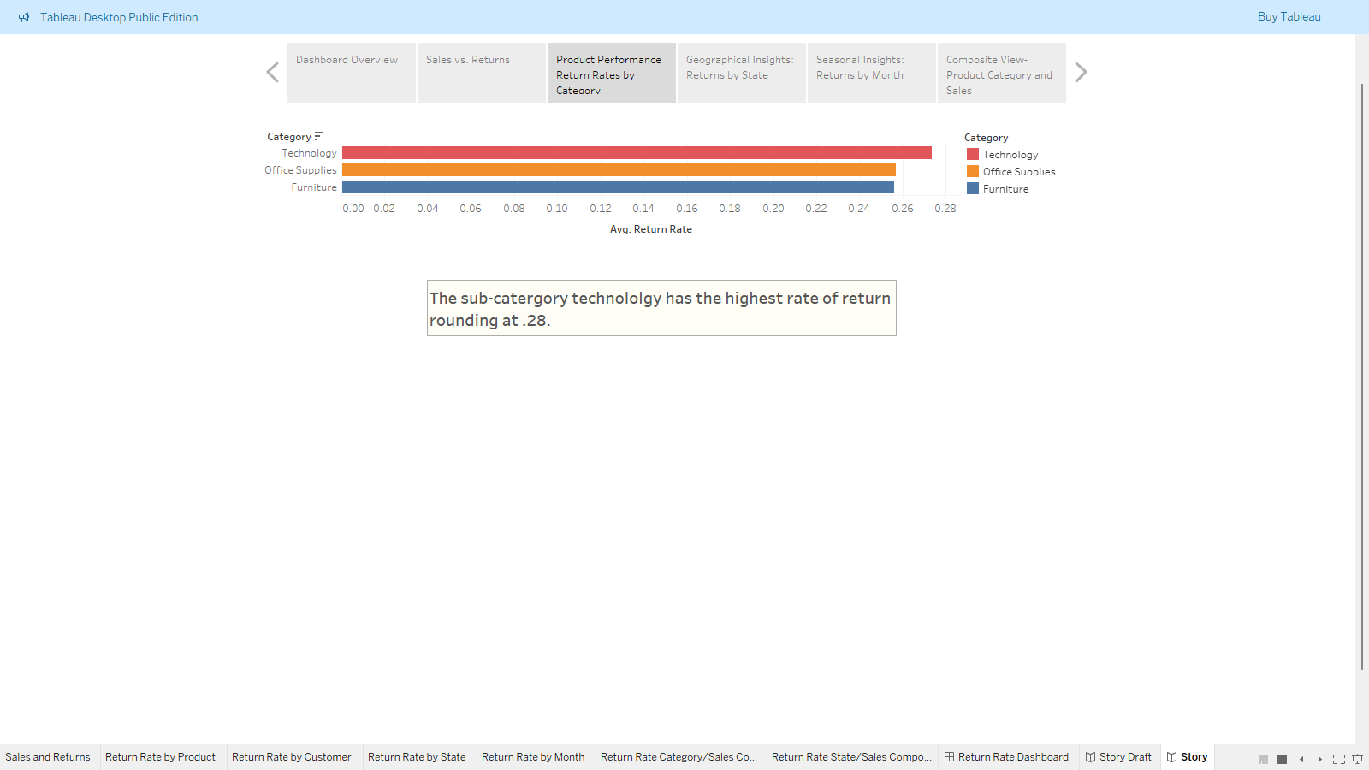
Return Rate by Product

Slide 5
Best Way to Measure
There are 3 different ways of measuring returns: return rate, total cost of returns, and total number of returns.
Return rate was the best measurement in this case because it measured behavioral insights.
Total cost of return is better when measuring financial impacts and total number of returns is best utilized when measuring logistics and inventory returns.

Slide 6
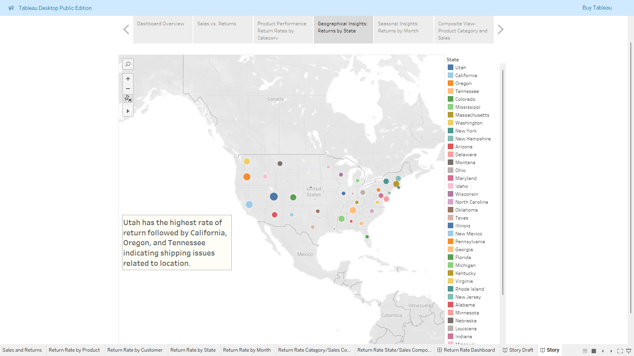
Return Rate by State

Slide 7
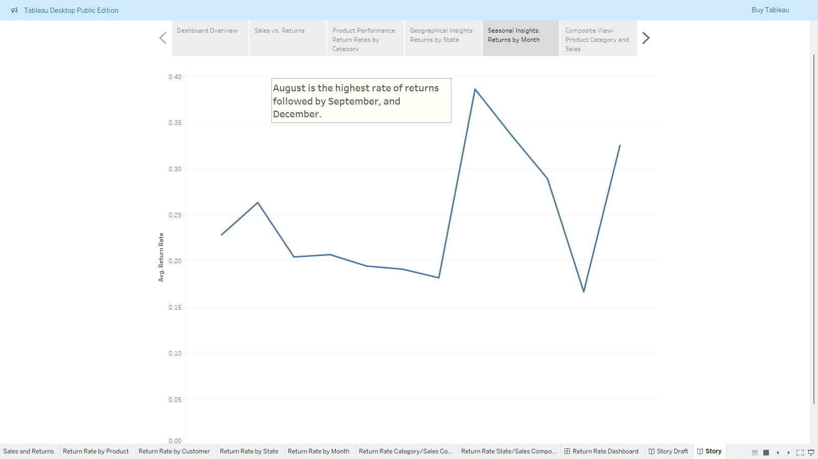
Return Rate by Month

Slide 8
Summary of Key Problem Areas
The root causes identified are:
product quality issues
size/specification mismatch
incorrect orders
customer expectations
seasonal factors
geographic trends

Slide 9
Summary of Key Problem Areas
Return Rate by Product bar chart displays the return rate by product category and identifies which categories have the highest proportion of returned products.
Return Rate by State map shows return rates by state and reveals that Utah at 57%, California and Oregon both at 45% show the three highest return rates.
Return Rate by Month line chart shows seasonal analysis revealing August is the highest rate of returns with 39% while November is the lowest with 17%.
Return Rate Category/Sales Composite chart shows analysis of product categories and sales reveals technology leads in both sales and return rates, showing potential quality issues despite strong market demand. Furniture and office have similar return rates, but higher sales volume suggests different underlying factors driving returns.

Slide 10
Summary of Key Problem Areas
The utilization of filters to identify root causes should start broad, then narrow.
Second, the filters should be in layer by combining them to drill deeper.
Finally, the utilization of filters is to prove or disprove your theories.

Slide 11
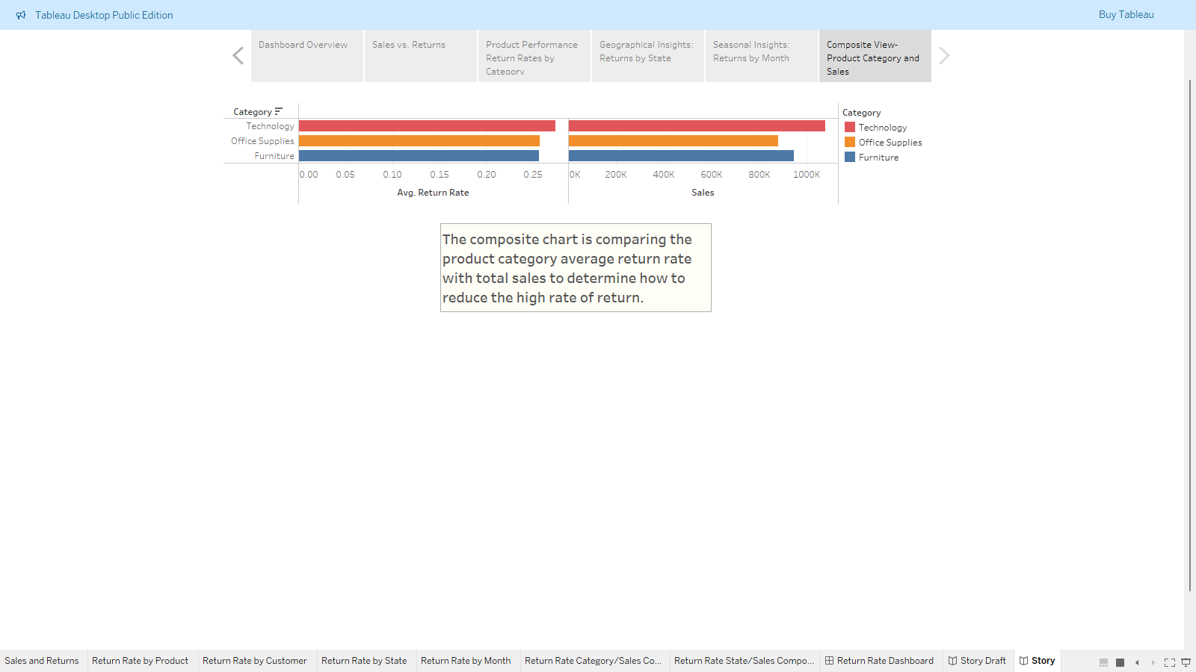
Return Rate Category/Sales Composite

Slide 12
Recommendations
After identifying root causes with the dashboard these actions should be taken to reduce the high rate of returns.
1) Product/Quality Improvements
2) Customer Experience Enhancements
3) Process Changes
4) Targeted Interventions

Slide 13
Recommendations
Address the root causes of the high rate of returns is to address product defects by working with suppliers to improve quality.
Addressing size/specification by enhancing product descriptions and images by updating product listings.
Addressing seasonal factors by adjusting inventory based on regional trends or seasonal patterns through targeted marketing.

